Slide 1

Insights to Food & Beverage Industry

Slide 2
Overview
Beverage company that is aiming to make its mark in the Indian market. A few months ago, they launched their energy drink in 10 cities in India.
Their Marketing team is responsible for increasing brand awareness, market share, and product development. They conducted a survey in those 10 cities and received results from 10k respondents. Peter Pandey, a marketing data analyst is tasked to convert these survey results to meaningful insights which the team can use to drive actions.

Slide 3
Data And Tools
The provided data is in separate 3 files (One is regarding Cities Information second is about respondents Information and third one is about the survey question asked from respondents)
Create Relationship among three data files in Power Bi Model View
Create Visualizations in Power BI

Slide 4
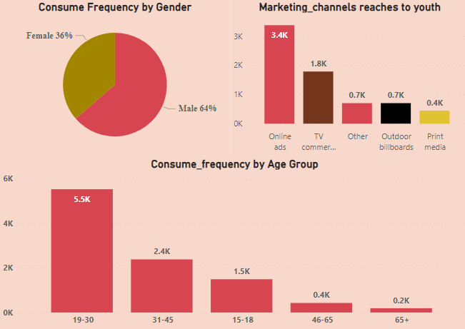
A) Who prefers energy drink more? b. Which age group prefers energy drinks more? c. Which type of marketing reaches the most Youth (15-30)?
Demographic Insights
Insight :-
Energy Drink Consume more by Men rather than Female
Energy Drinks are popular among Youth range age from 19 -30 followed by middle age 31-45. Senior citizen consume it less
Online Ads increase the reach of Drinks among youth followed by TV Commercials

Slide 5
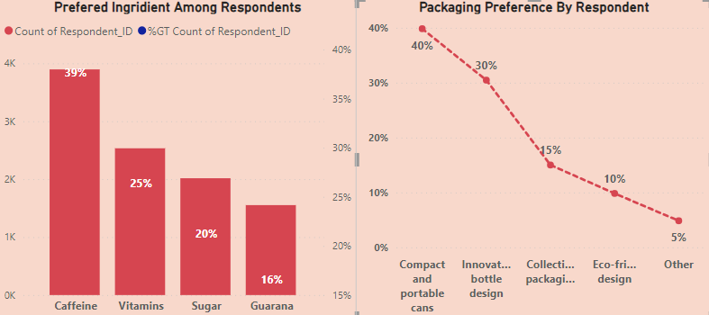
A) What are the preferred ingredients of energy drinks among respondents? b. What packaging preferences do respondents have for energy drinks?
Consumer Preferences
Insight :-
According to the survey results, most of the respondents (39%) expect caffeine, followed by vitamin (25%) and sugar (20%).
The majority of respondent 40% prefer Compact and portable cans, while Innovation bottle design ranks second with 30 %. Respondent less prefer Eco – friendly design which is 10 %.

Slide 6
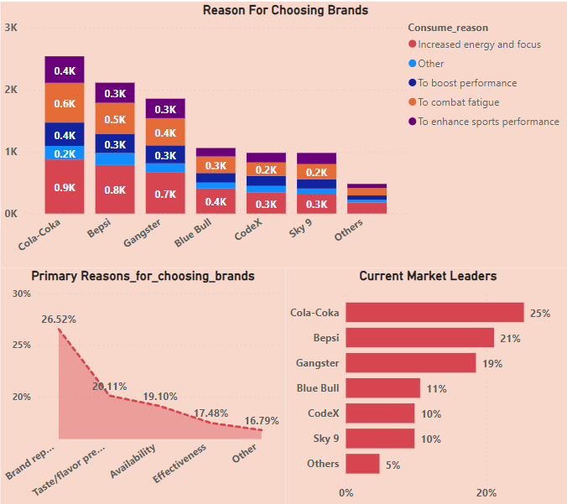
A) Who ARE THE CURRENT MARKET LEADER? b. What are the primary reasons consumers prefer those brands over ours?
Competition Analysis
Insight :-
Cola-Coka is the current market leader among all respondent by achieving 25% response followed by Bepsi acquiring 21%. CodeX and Sky 9 are having same response
According to Survey, primary reason to choose other brands are their brand reputation followed by Taste and Availability.

Slide 7
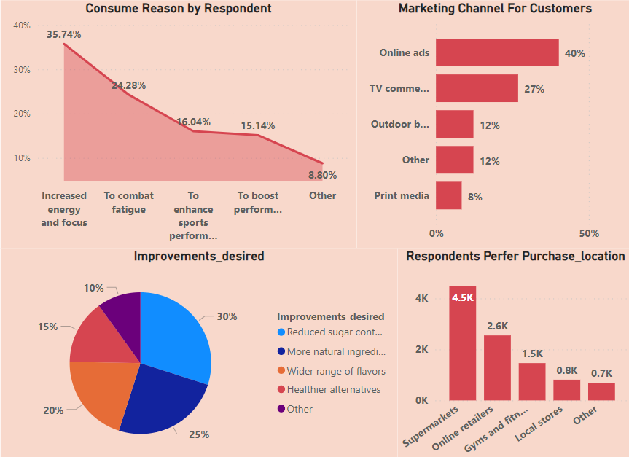
a. Which marketing channel can be used to reach more customers? b. How effective are different marketing strategies and channels in reaching our customers?
Marketing Channels and Brand Awareness
Insight :-
Online ads has more effect to increase sale of energy drinks over respondent whereas TV commercial secured second position in marketing. Consumer less prefer print media.
According to survey, consumers demand some improvements in reducing Sugar content and add natural ingredients also add some flavors in it
Increase the availability in prefer locations like super market, online retailers and Gym

Slide 8

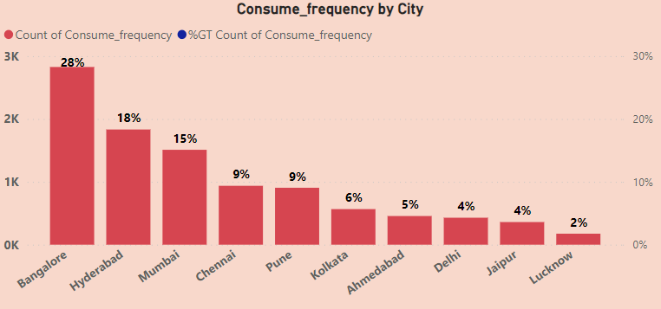
a. What do people think about our brand? (overall rating) b. Which cities do we need to focus more on?
Brand Penetration
Insight :-
In this analysis, I aimed to determine the average rating given by individuals. I utilized the 'taste experience' field. We saw overall rating is 3.2 which means there need significant improvement in taste.
The respondents were primarily from Bengaluru, followed by Hyderabad and Mumbai.

Slide 9
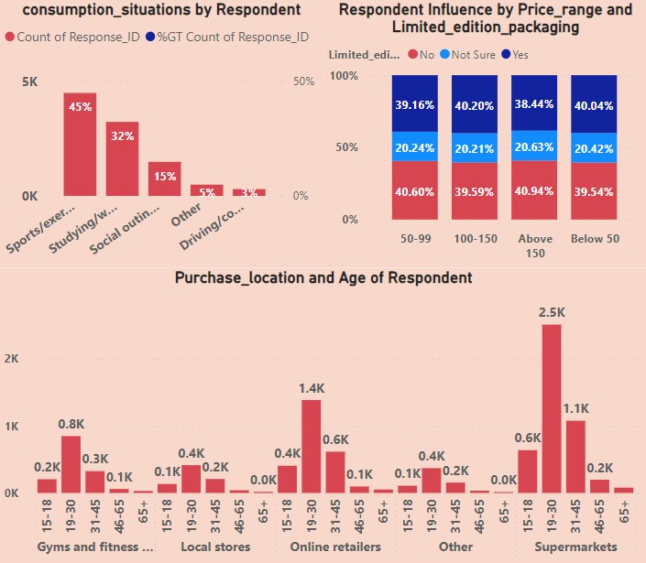
a. Where do respondents prefer to purchase energy drinks? b. What are the typical consumption situations for energy drinks among respondents? c. What factors influence respondents' purchase decisions, such as price range and limited edition packaging?
Purchase Behavior
Insight :-
According to the data analysis, the preferred place to buy for each age group is the 'Supermarket,'. The second and third positions are occupied by ‘Online retailer' and 'Gym and Fitness centers,' representing the market, respectively. 'Local stores' make up less in the market.

Slide 10
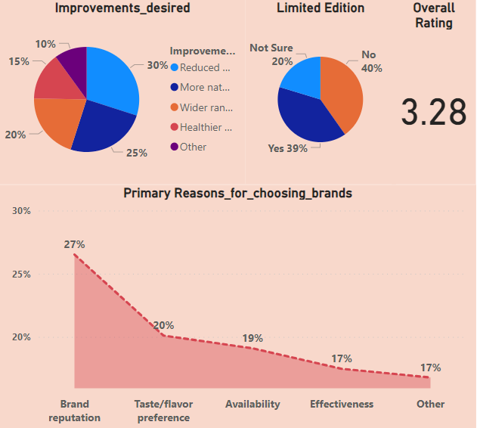
a. Which area of business should we focus more on our product development? (Branding/taste/availability)
Product Development
Insight :-
According to analyze firstly, more focus should on Taste development because its overall rating is 3.2 out of 5 then over availability, people talk about their limited edition

Slide 11
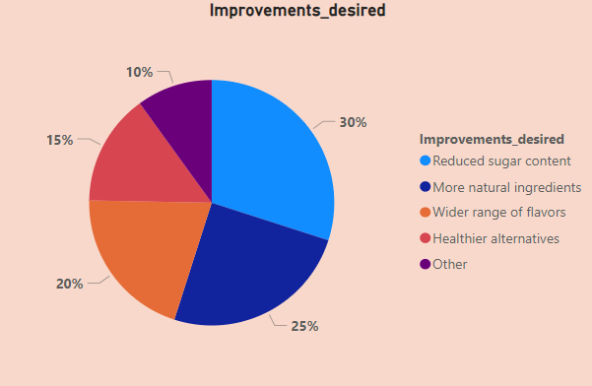
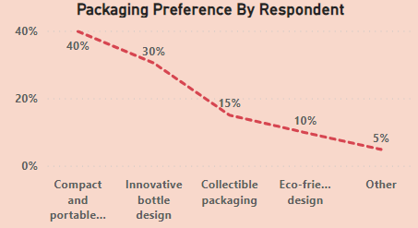
What immediate improvements can we bring to the product?
Reduced sugar content in the energy drinks.
Add more natural ingredients.
Another aspect that garnered attention was a wider range of flavors
Another improvement Should be in Packaging. People prefer Compact & Portable cans and Innovative bottle design

Slide 12
What should be the ideal price of our product?
The ideal price range for the product should be between 50 and 100, as suggested by the analysis. This range is aligned with the affordability and perceived value preferences of the target audience

Slide 13
What kind of marketing campaigns, offers, and discounts we can run?
Marketing campaigns should focus on promoting the health benefits of the product, reduced sugar content and natural ingredients. Offering discounts and incentives to consumers can be effectively strategy to encourage product adoption and increase initial brand awareness. Collaborating with fitness centers, gyms, and online platforms can also be effective in reaching the target audience.

Slide 14
Who can be a brand ambassador, and why?
An ideal brand ambassador could be a well-known fitness influencer or Sports Person who aligns with the brand's values of promoting a healthy and active lifestyle. This individual can help endorse the product's benefits, create awareness among the target audience, and establish credibility and trust.

Slide 15
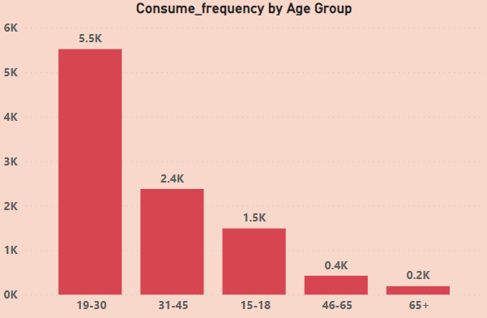
Who should be our target audience, and why?
The target audience should primarily focus on health-conscious individuals aged 15-30 who are active in fitness and exercise. This segment is more likely to prioritize energy-boosting drinks and be receptive to the product's reduced sugar content, natural ingredients, and association with gym and fitness centers. Additionally, marketing efforts can be extended to reach individuals aged 31-45 who have higher income levels and may be willing to invest in premium products.

Slide 16
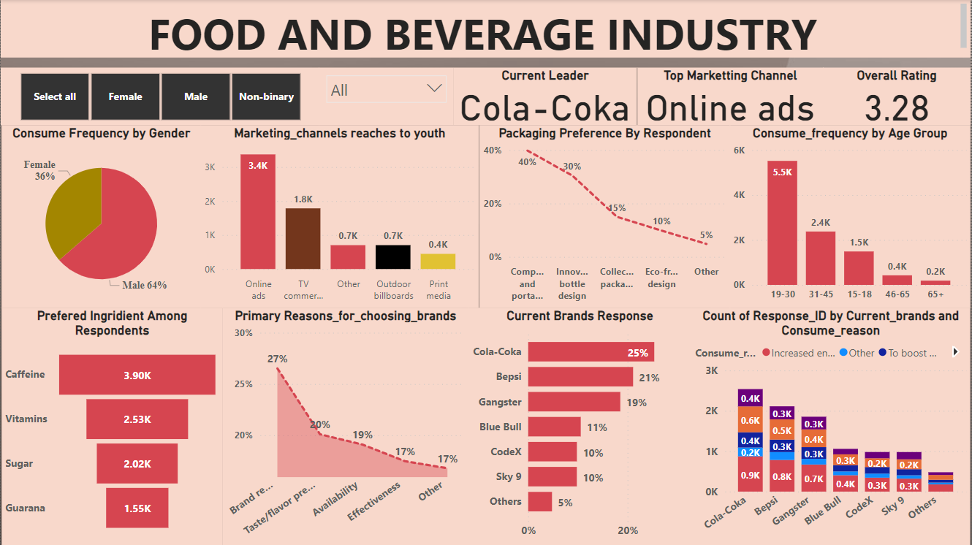

Slide 17
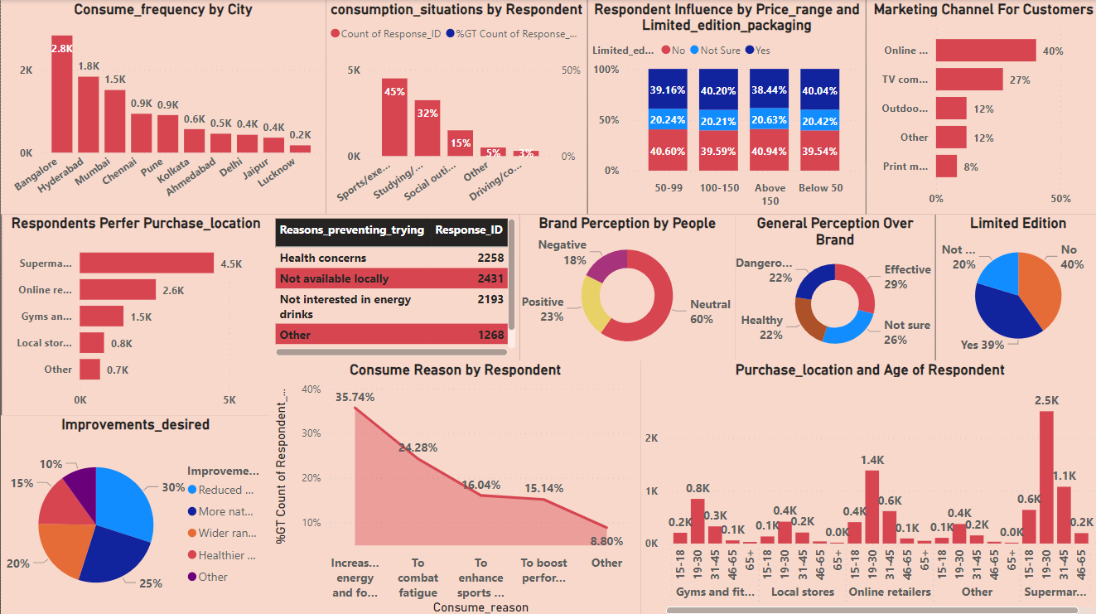

Slide 18
THANK YOU Sukhpaldeep Kaur

